Slide 1

Automated Hyperspectral Pyrometry of Bulk Crystal Growths
Naman Parikh¹, Tyrel McQueen^{3,4,5,6}, David Elbert^{2,3}
¹Carnegie Mellon University, ²Institute for Data Intensive Engineering and Sciences, ³Hopkins Extreme Materials Institute, ⁴JHU Department of Materials Science and Engineering, ⁵JHU Department of Chemistry, ⁶Institute for Quantum Matter

Slide 2
How hot is this?

Slide 3
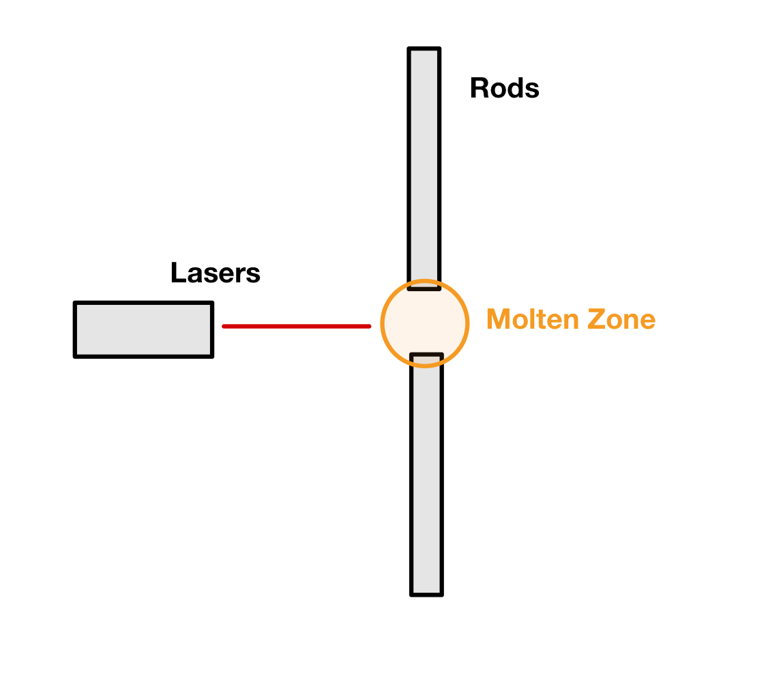
Floating Zone Furnaces

Slide 4
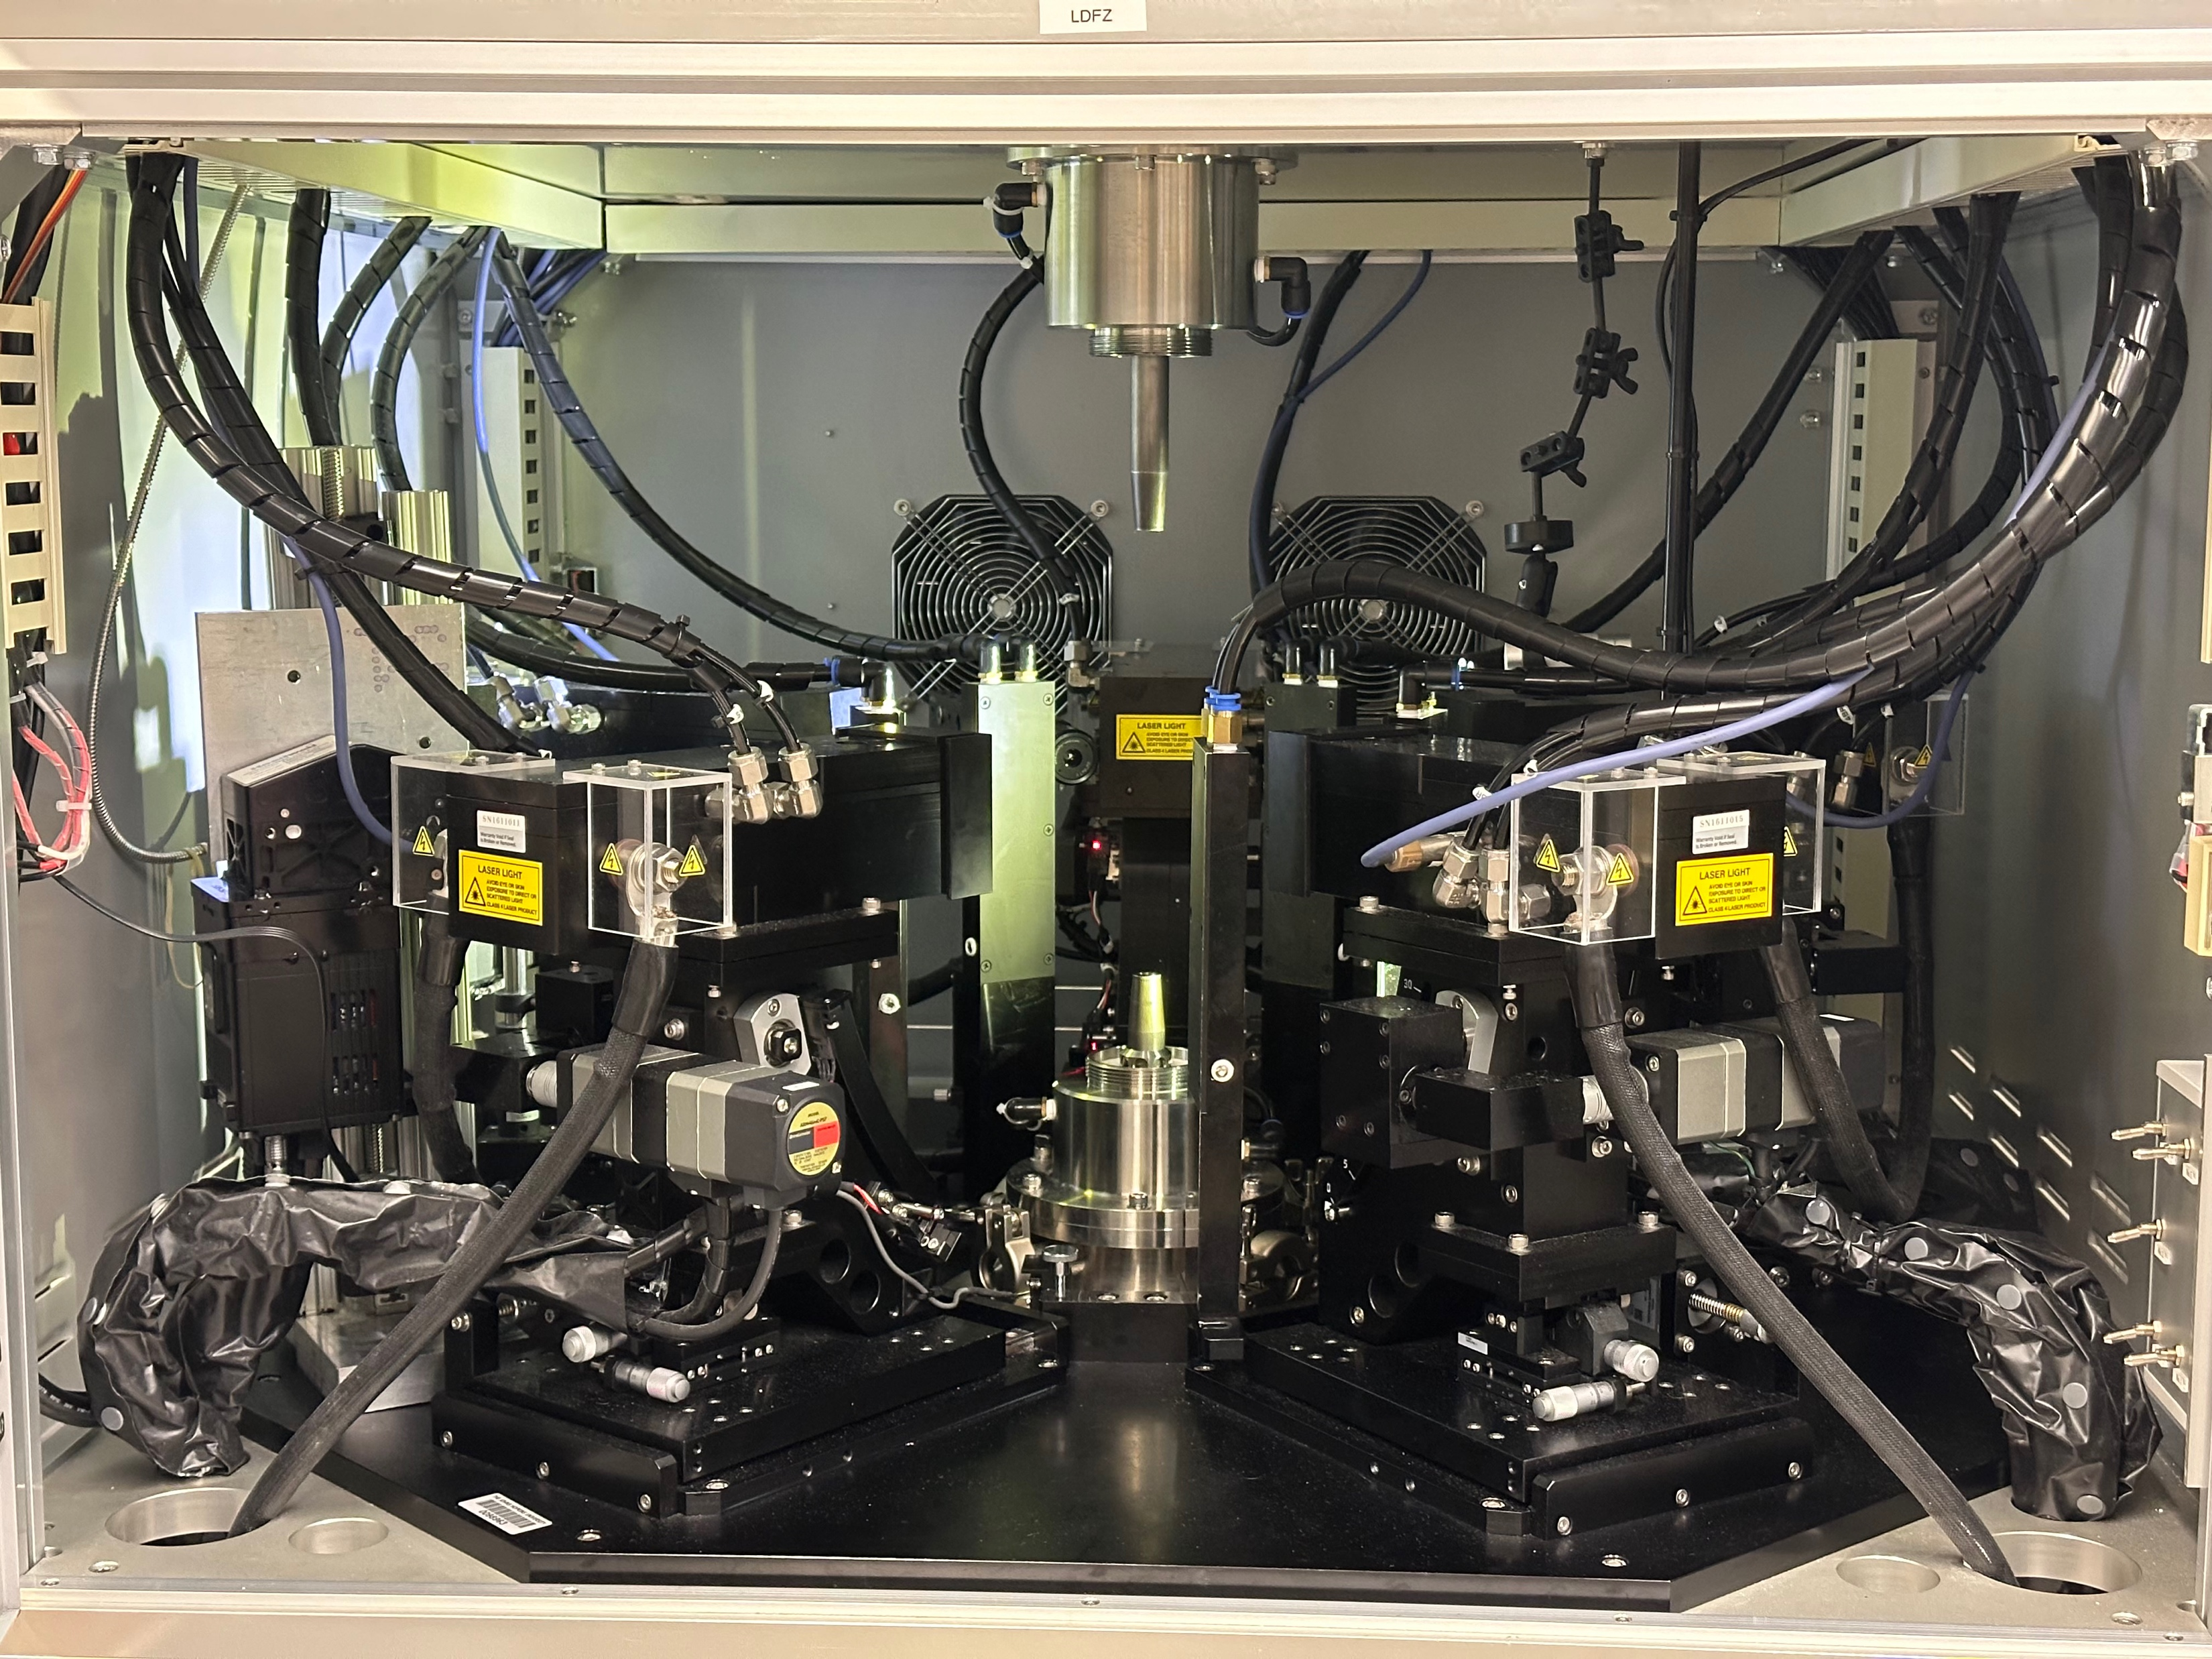

Slide 5
Benefits
Control over the growth process
Relatively quick growths
Can be pressurized to create an isolated environment

Slide 6
Physics of the molten zone is largely unknown
Thermal Gradient
Heat transfer

Slide 7
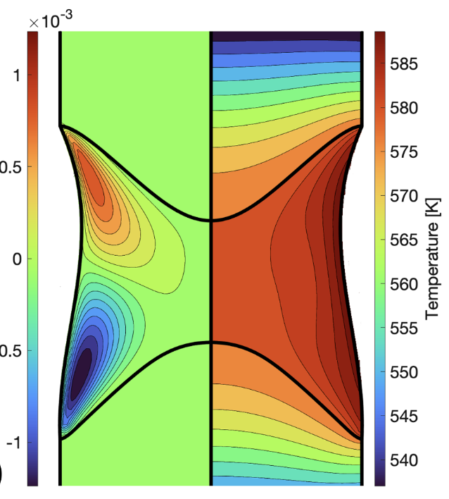
Modeling – NaNO₃
Scott S. Dossa, Jeffrey J. Derby
https://doi.org/10.1016/j.jcrysgro.2022.126723
Notes:
The temperature and thermal gradient throughout the molten zone is a fundamental parameter in how the growth happens and the resulting crystal
Takes temperature field as an initial input, models the fluid and heat flow
Is not connected to actual temperature data

Slide 8
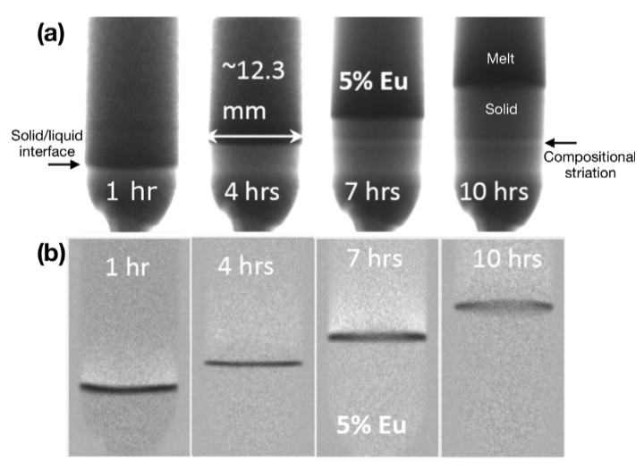
Nuetron Imaging – BaBrCl:5%Eu
Jeffrey J. Derby, et. al.
https://doi.org/10.1016/j.jcrysgro.2020.125572
Notes:
This imaging is can track the liquid/solid interface but is not able to probe the thermal gradient or heat characteristics

Slide 9
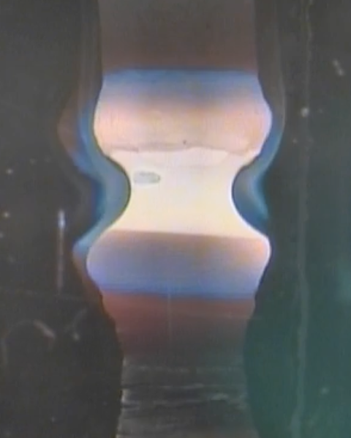
LDFZ Video
PARADIM Summer School 2022
https://data.paradim.org
Notes:
There’s a lot of qualitative information here, but we have no quantitative measurement of temperature and the small variations throughout the molten zone

Slide 10
Molten Zone Temperature
Crystal Properties
Notes:
The temperature and the thermal distribution will affect the properties of the crystal we grow, but we don’t know exactly how. If we did, we could reverse engineer what we want the thermal distribution should look like during a growth. If we could have a live feed of the thermal distribution, we could compare what we have to what we want. From there we would want to know how to get what we want and how to make adjustments if needed

Slide 11
Materials Used:
Chemical Properties
Molten Zone Temperature
Furnace Controls:
Rotation Speed
Pull Rate

Slide 12
Materials Used:
Chemical Properties
Molten Zone Temperature
Crystal Properties
Furnace Controls:
Rotation Speed
Pull Rate
Notes:
Once we have the knowledge going forward, we can go backwards, using temperature of the molten zone as a middleman to figure out how to get the crystal properties we want and use that information to make adjustments in real time
Here I need to explain why this model means that we need to be able to collect temperature data in real time

Slide 13
Can all of this be automatic?
Notes:
What do we need to make this happen?

Slide 14
Research Question

Slide 15
Research Question
How can we measure the temperature of an ongoing growth in real time?

Slide 16
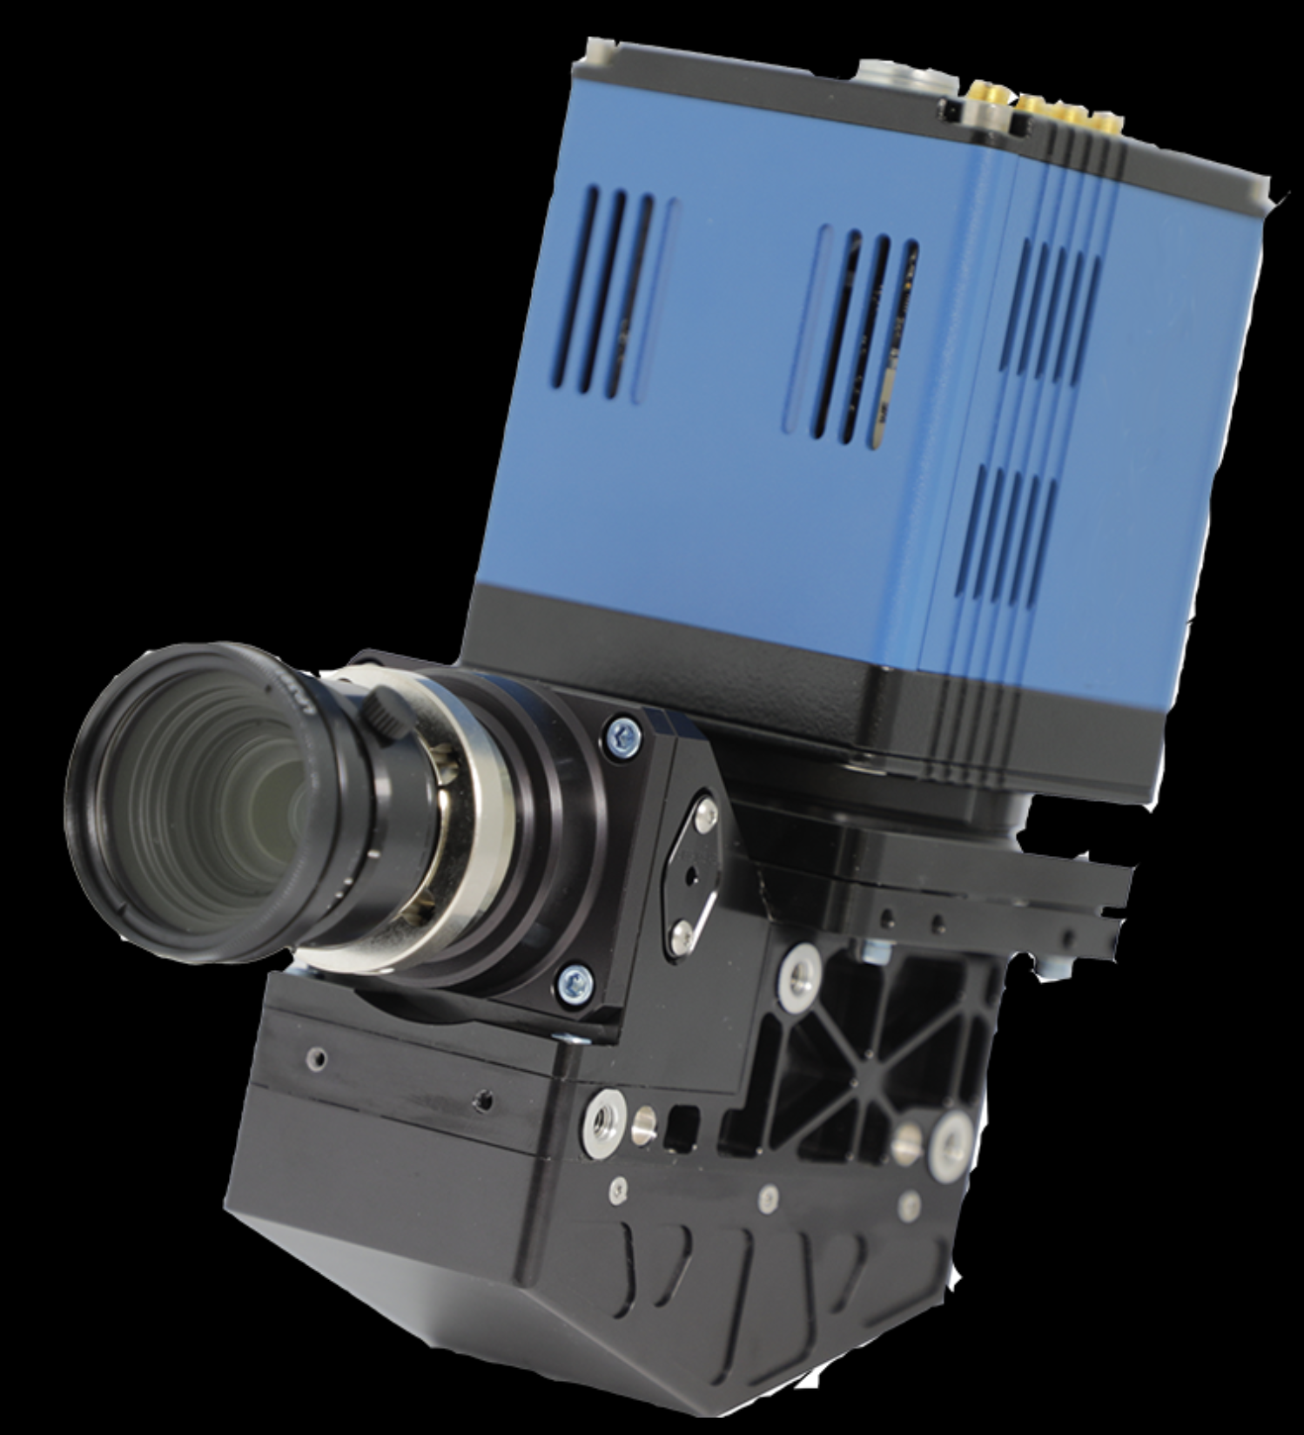
Hyperspectral Camera
Notes:
Ours is not blue :(

Slide 17
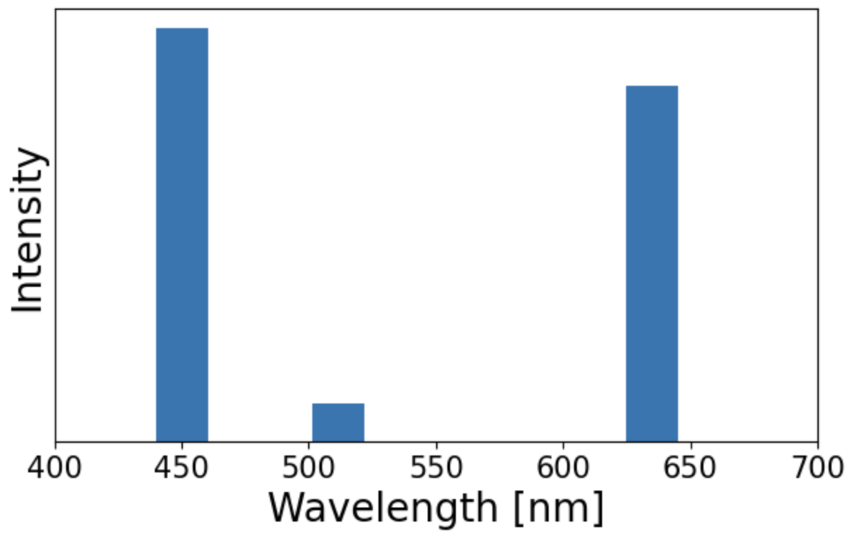
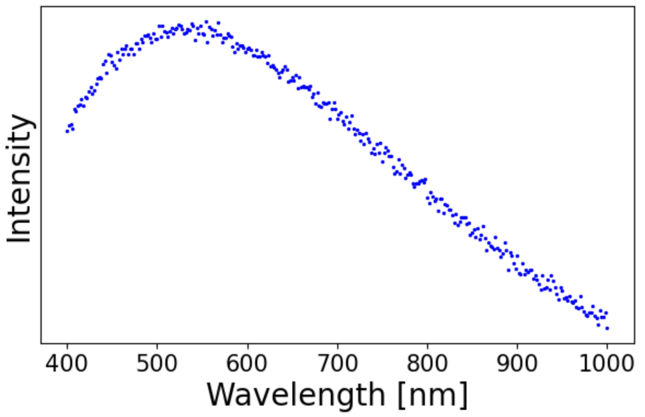
Hyperspectral
Traditional

Slide 18
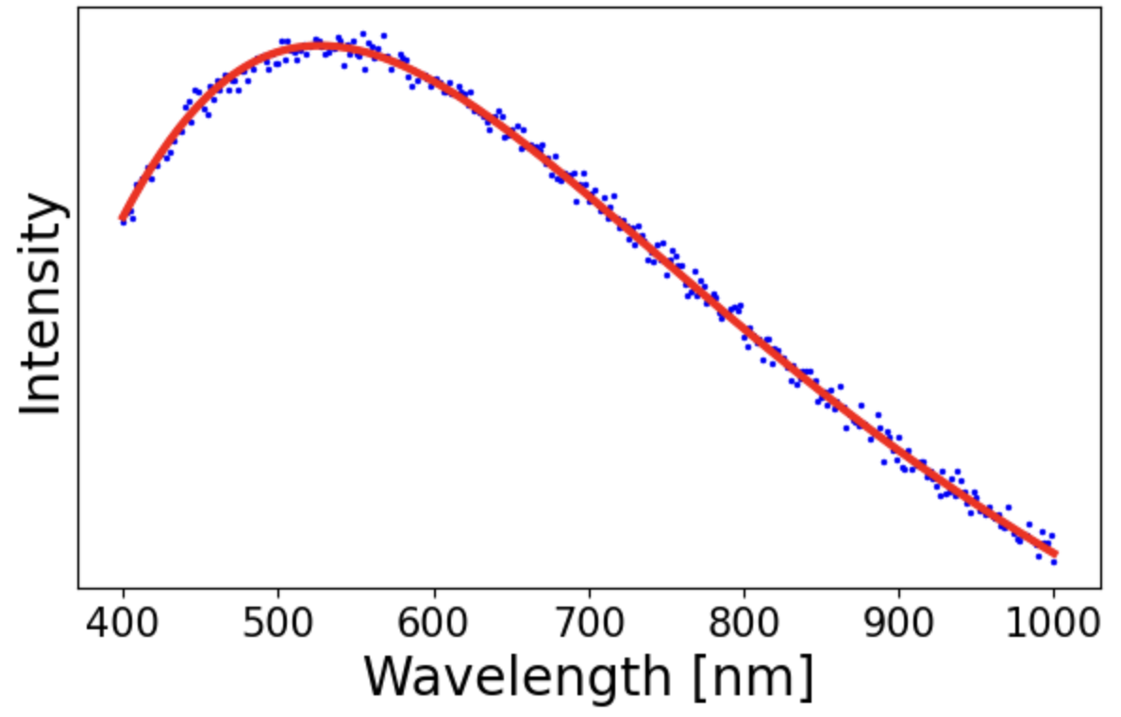
Why hyperspectral?
Notes:
With more than 3 wavelengths, we can make interpolate the data into a blackbody radiation spectrum. The exact shape of a spectrum uniquely determines the temperature, so using some machine learning on this will get us temperature values for each pixel

Slide 19
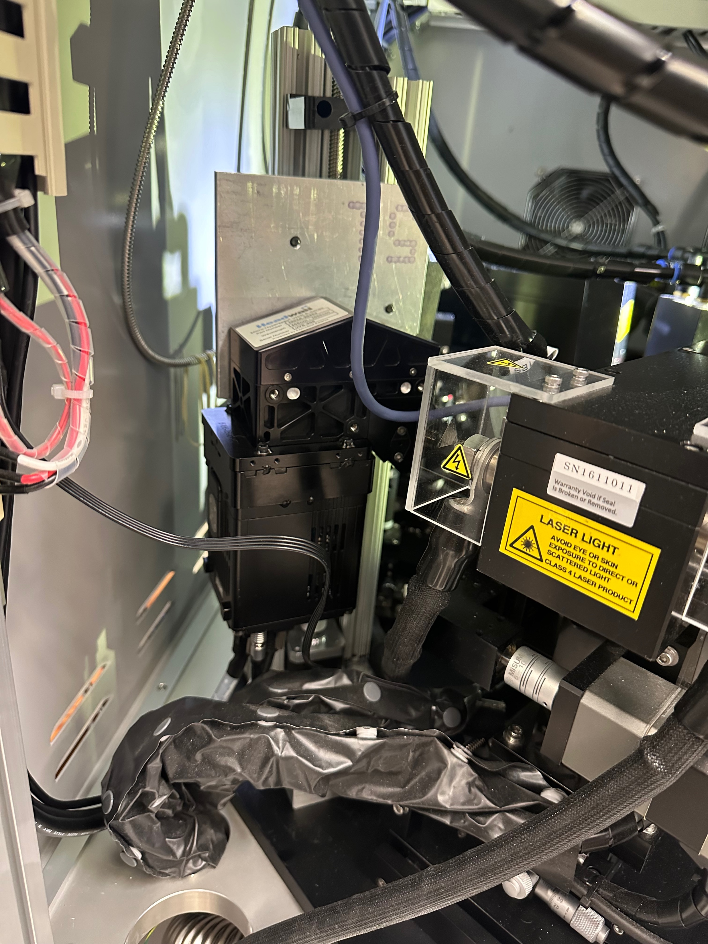
Part 1: Physical Mount

Slide 22
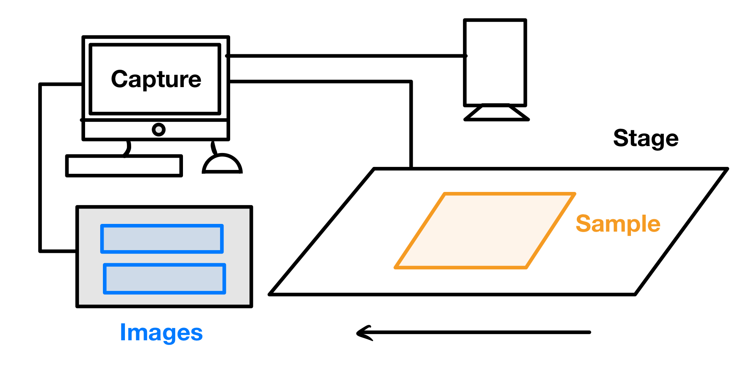

Slide 23
The camera needs to move!

Slide 24
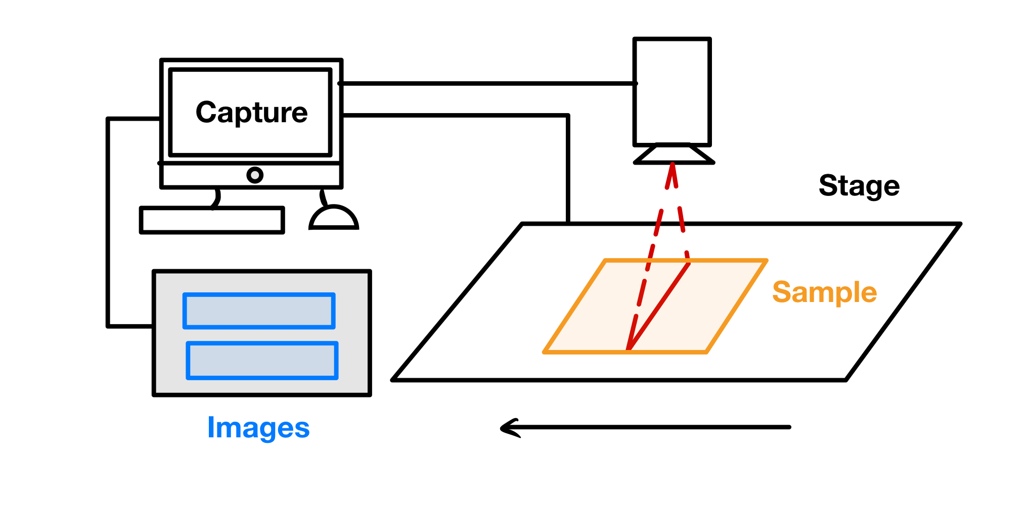
Notes:
Why does it need to move?
Important to note that the computer syncs the start of the image capture and the movement of the stage

Slide 25
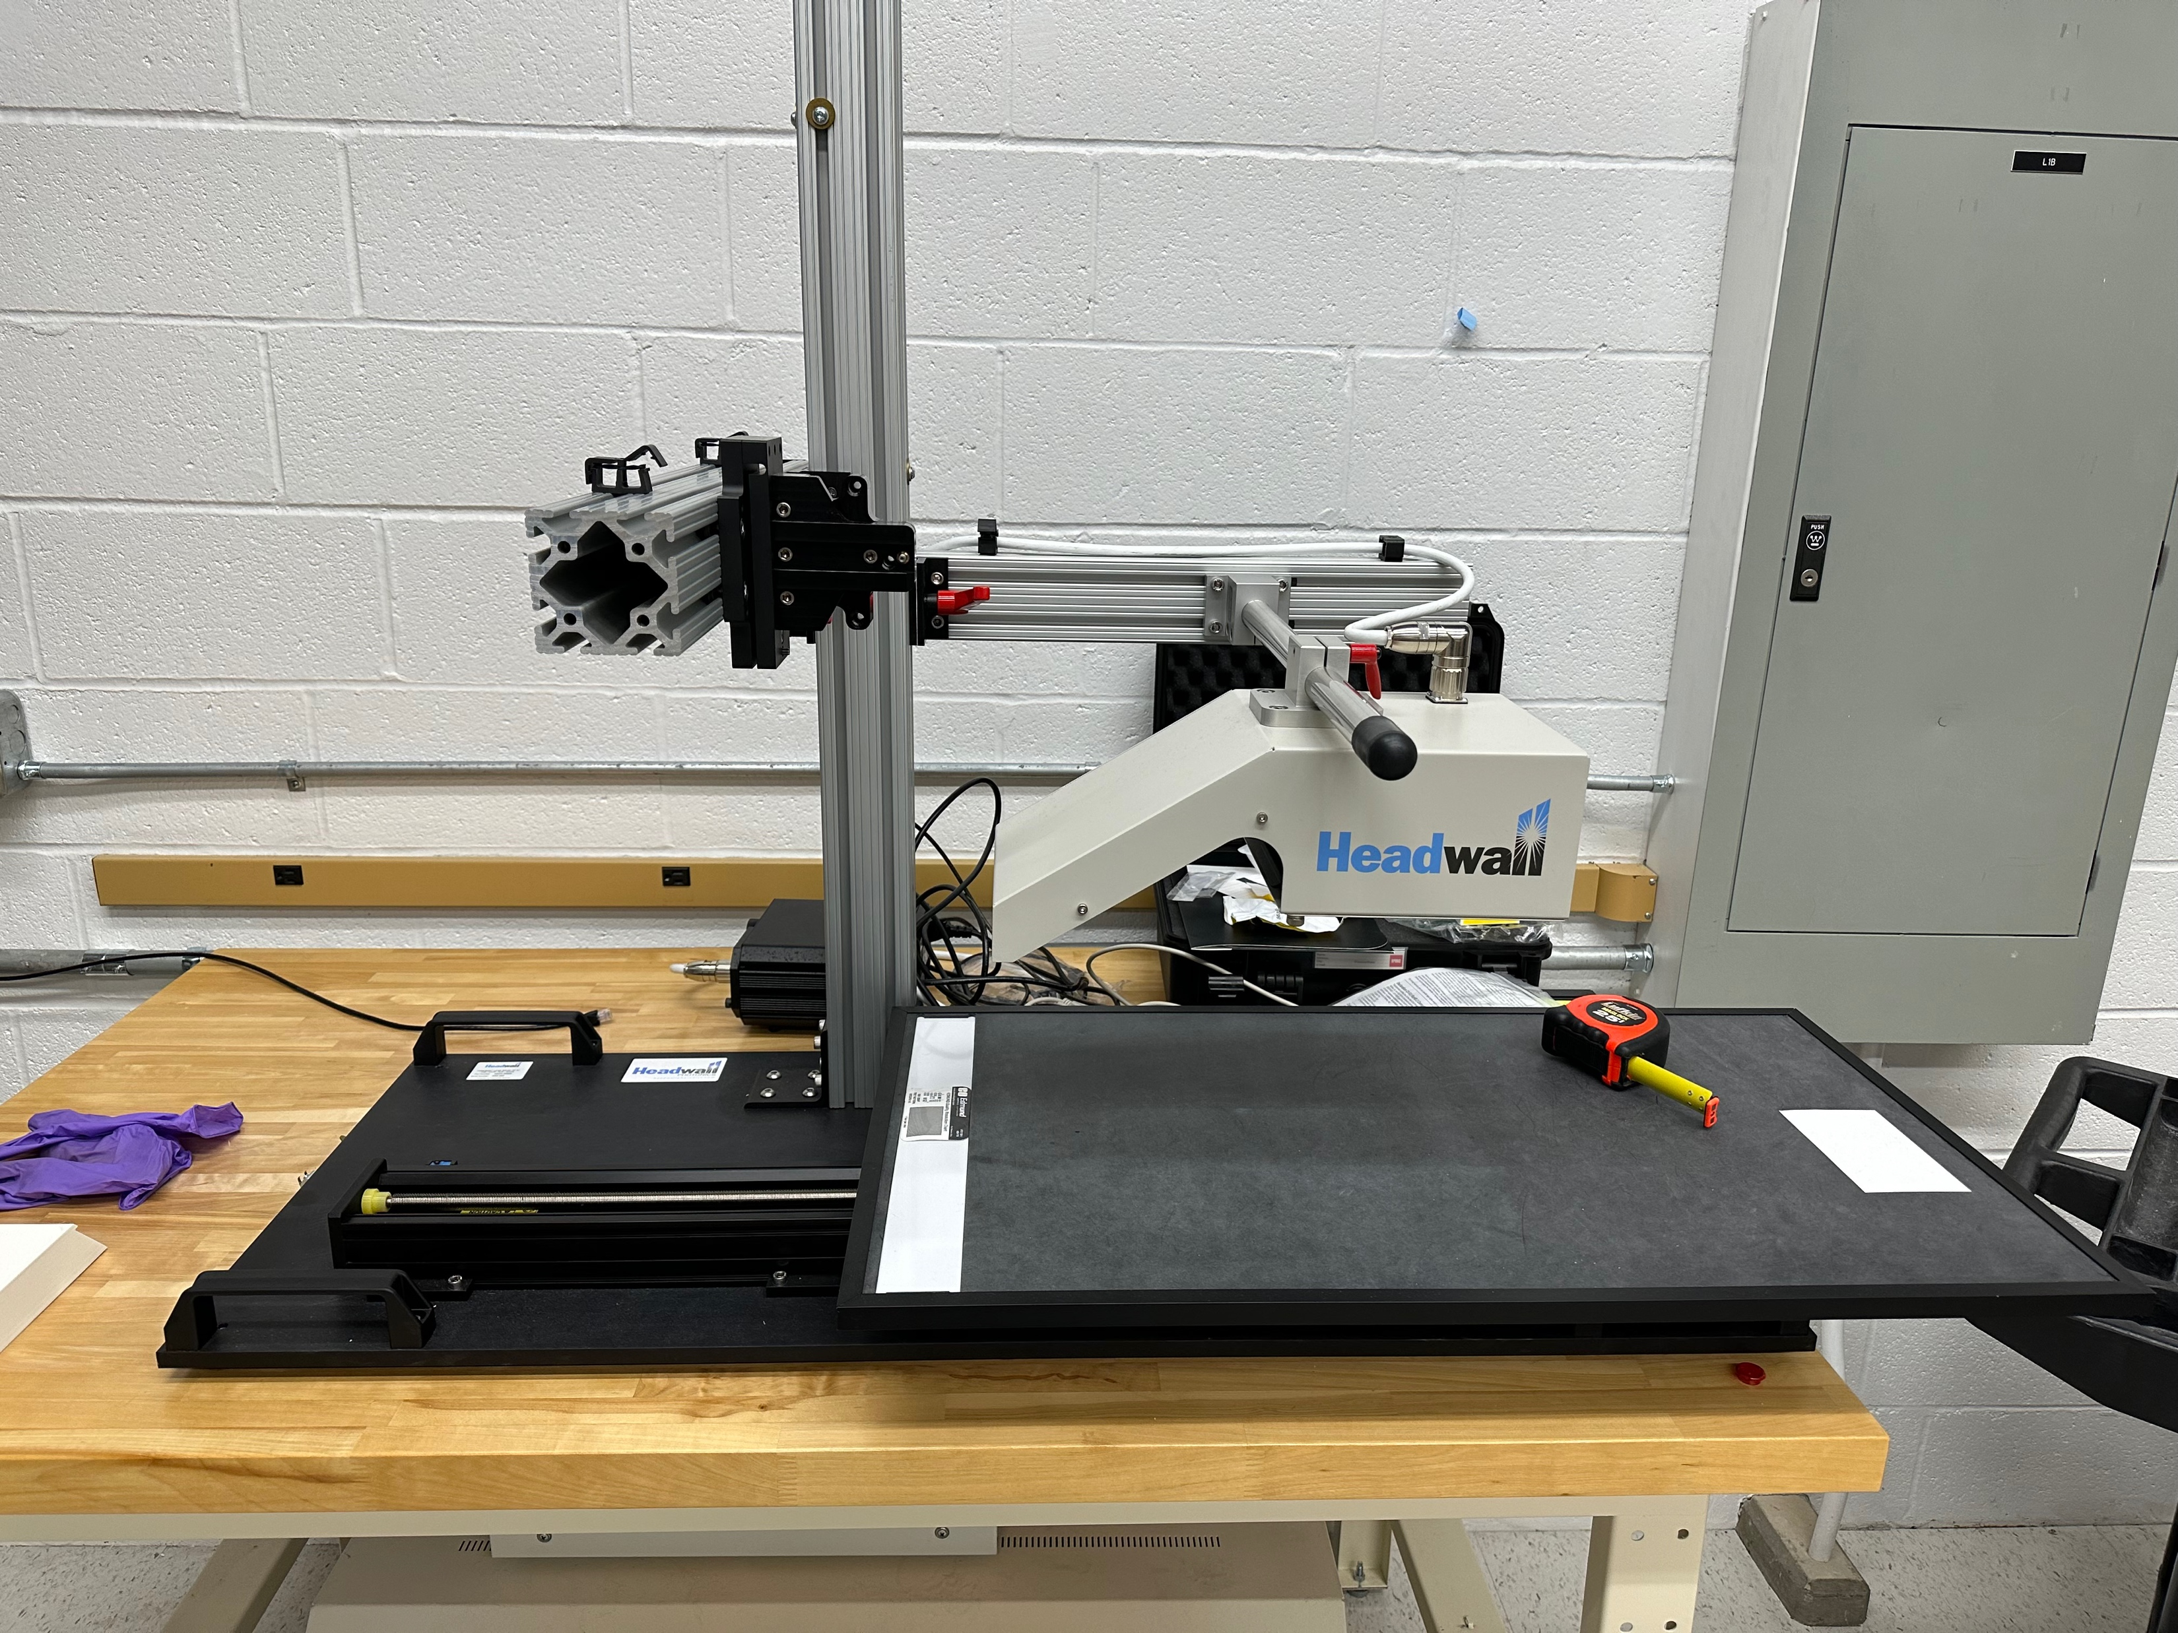

Slide 26
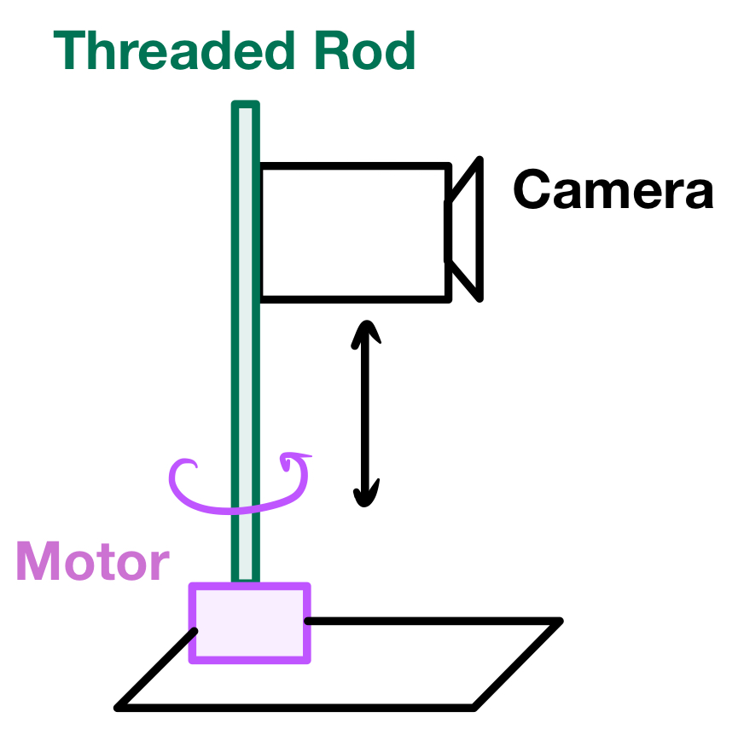
Notes:
How do we make it scan?

Slide 27
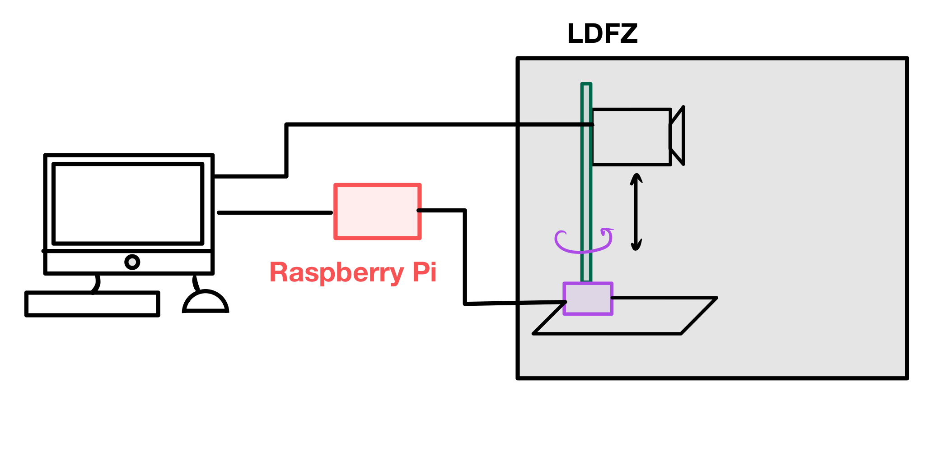
Notes:
How do we sync the motor with the image capture? We are replacing the stage with the motor

Slide 28
R-Pi mimics the stage
Signals from stage

Slide 29
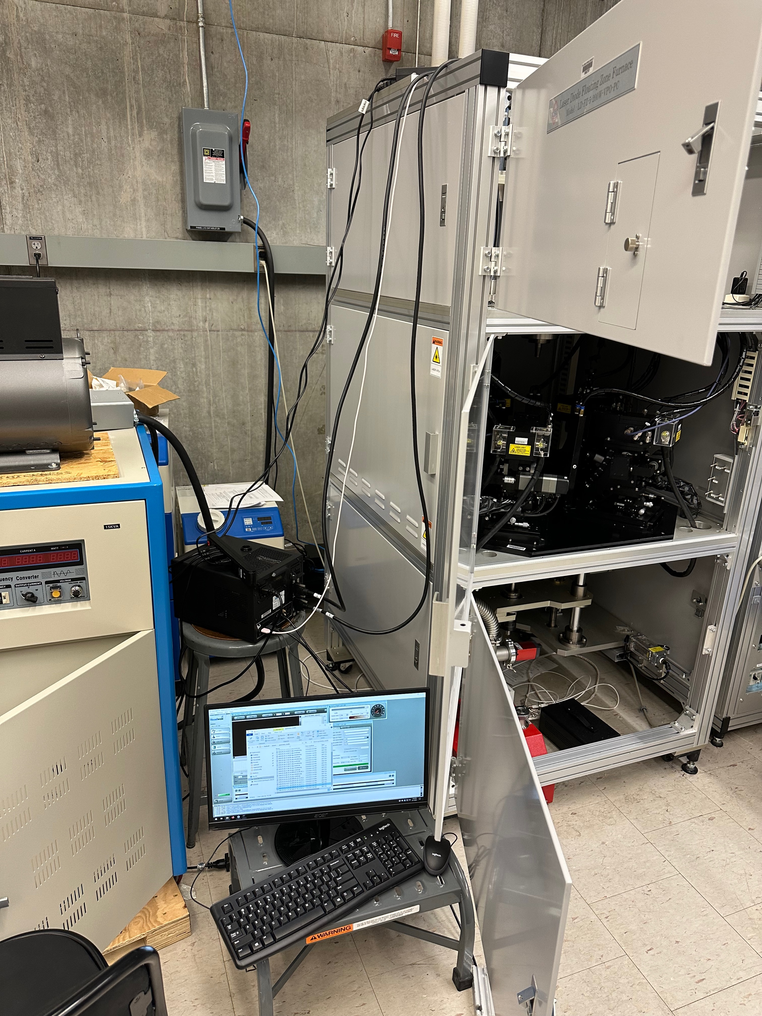

Slide 30
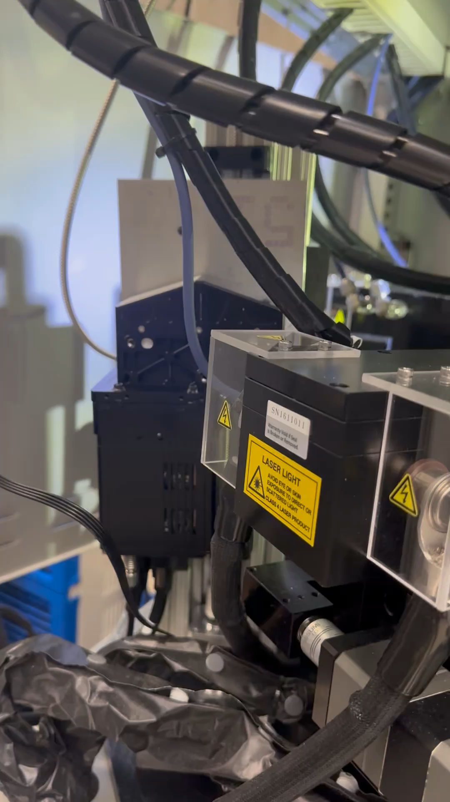

Slide 31
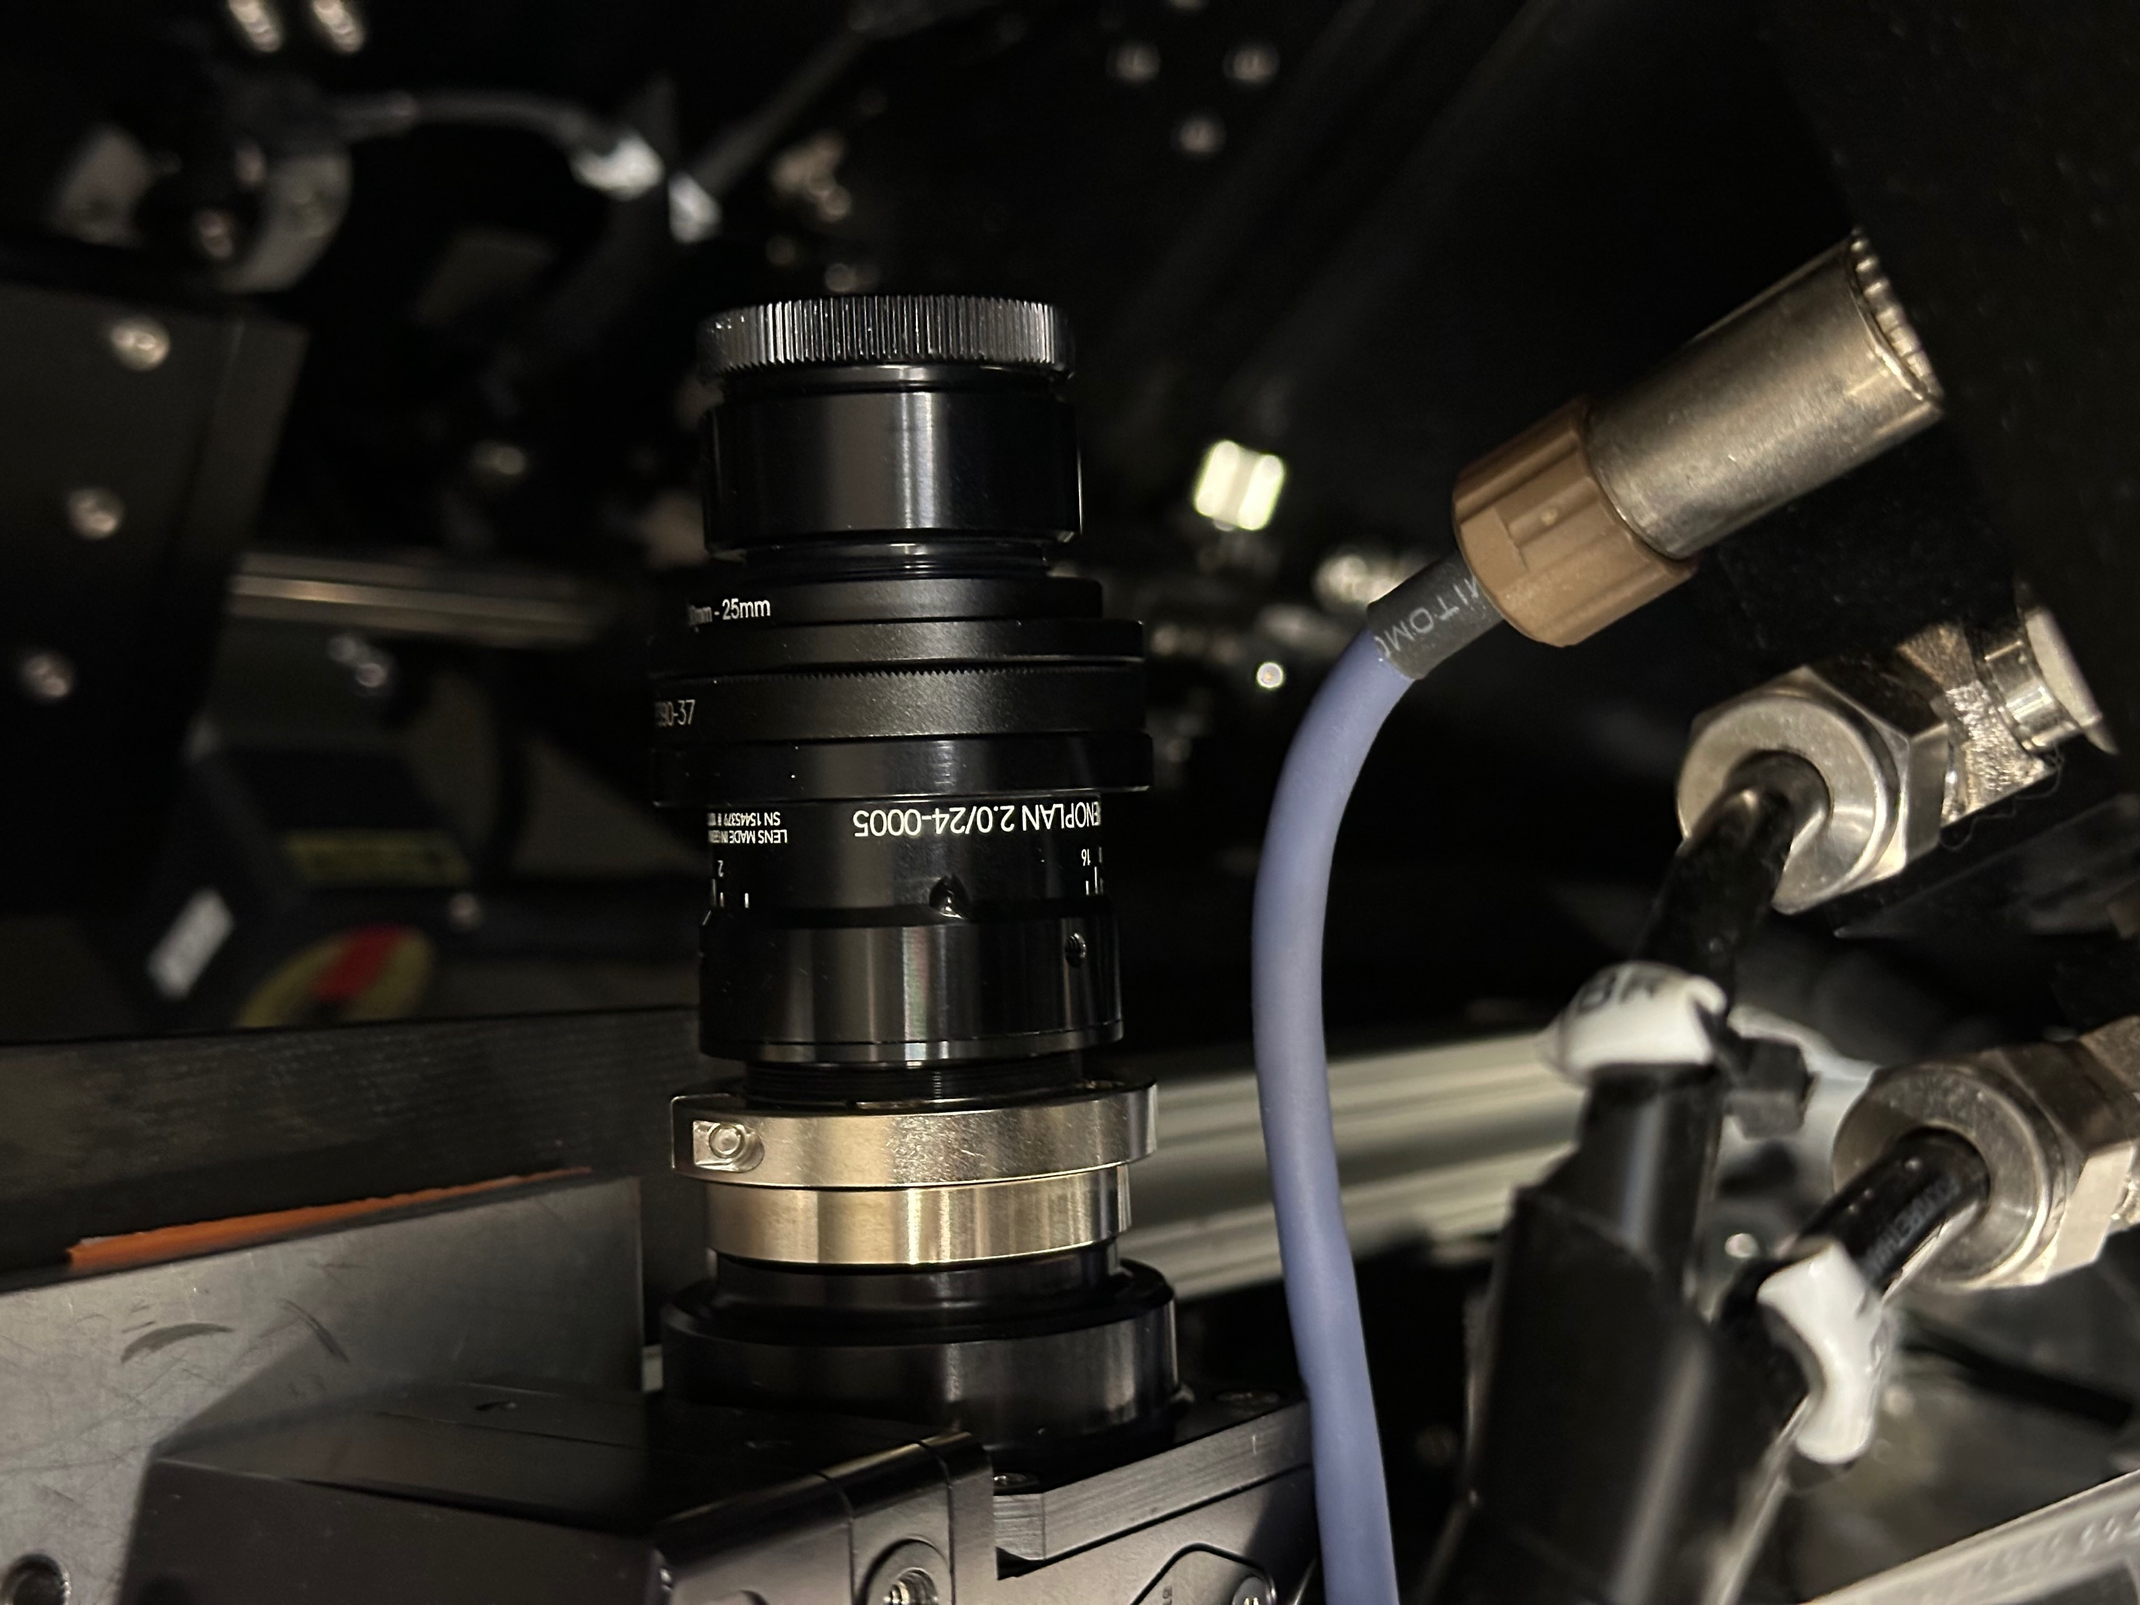
Detector
Lens
Notch Filter
Notes:
Problem: Need to protect camera detector from stray laser light that could damage it

Slide 32
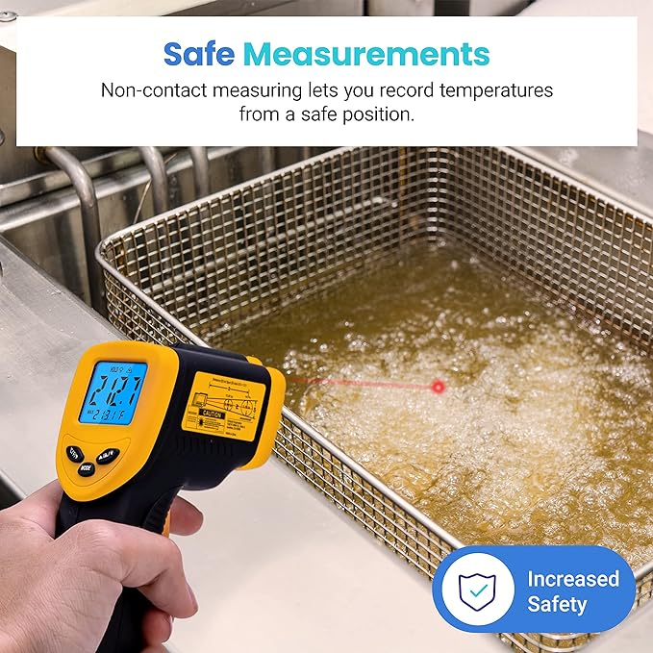
Part 2: Temperature Analysis
Etekcity Infrared Thermometer Temperature Gun 774, Digital IR Temp Gun for Food, Cooking, BBQ, Pizza Oven, Reptile, Griddle Accessories, Non Contact Surface Outdoor Heat Gun

Slide 33
Molten zone is a black-body
5500 K
Notes:
The shape of the black-body spectrum is unique to the temperature (for example, the wavelength of the peak), so we can determine temperature using the spectrum measured by the camera

Slide 34
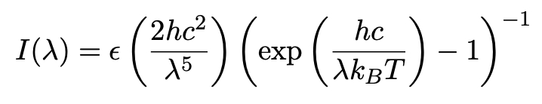
Notes:
Wavelength will be the independent variable, epsilon is emissivity

Slide 35
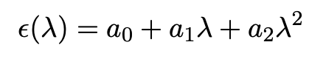

Slide 36
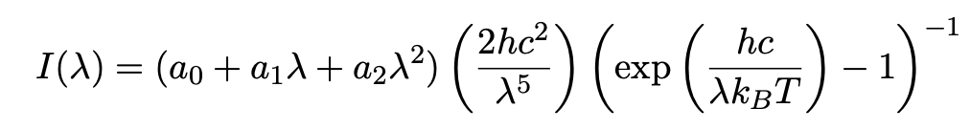

Slide 37
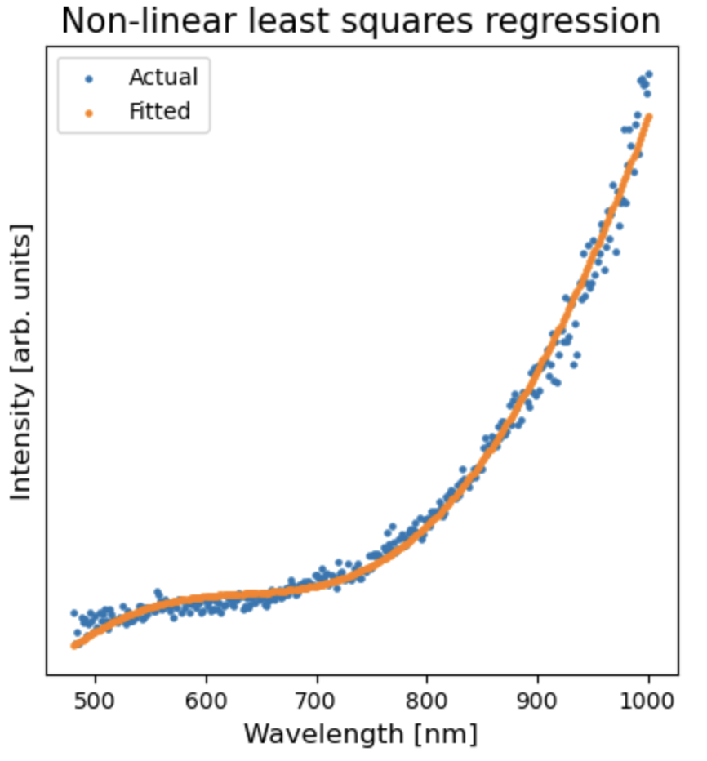
Heated Carbon Rod Testing
3000 K
Notes:
The shape of the black-body spectrum is unique to the temperature (for example, the wavelength of the peak), so we can determine temperature using the spectrum measured by the camera
Explain thoroughly what’s happening in the graph

Slide 38
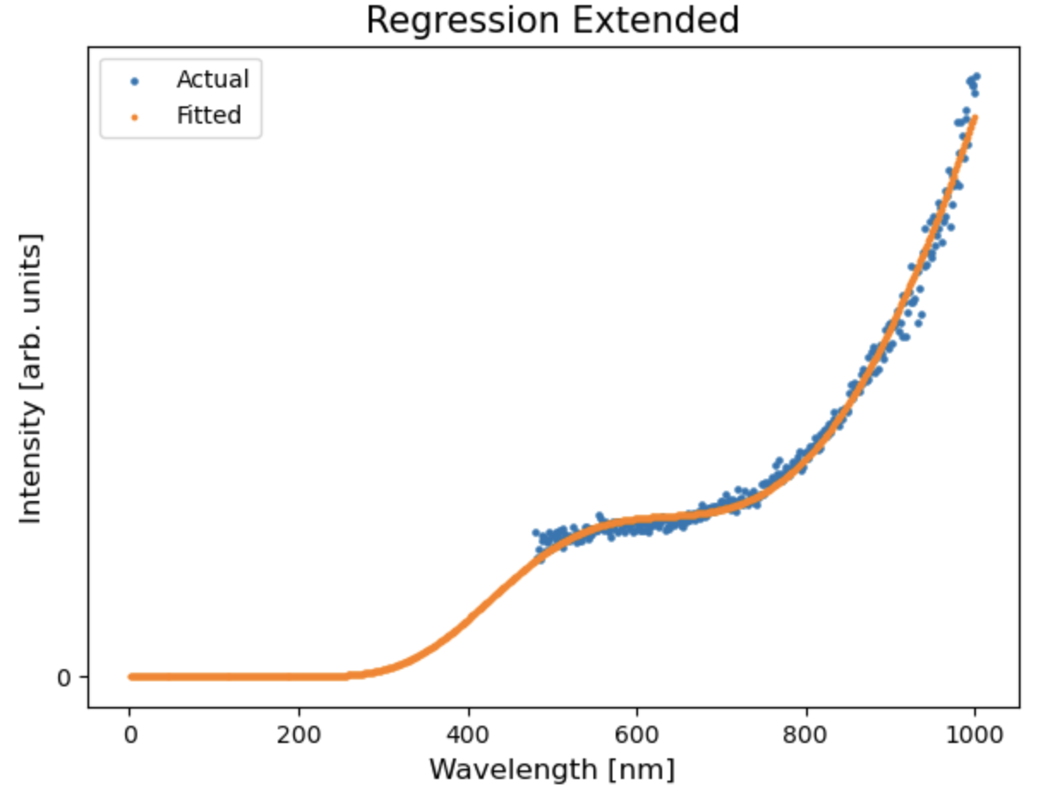

Slide 39
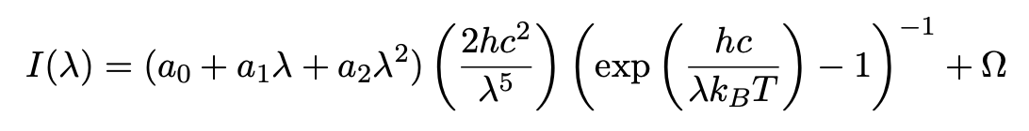

Slide 40
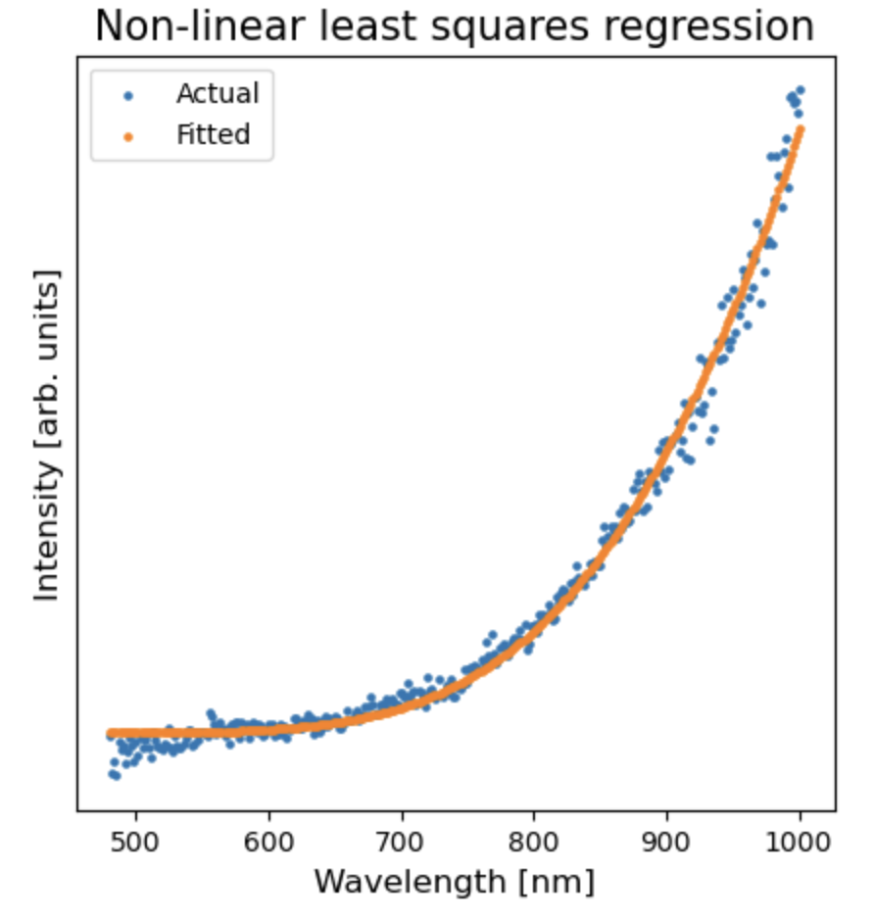
Heated Carbon Rod Testing
Notes:
The shape of the black-body spectrum is unique to the temperature (for example, the wavelength of the peak), so we can determine temperature using the spectrum measured by the camera
Explain why this gives is better than before

Slide 41
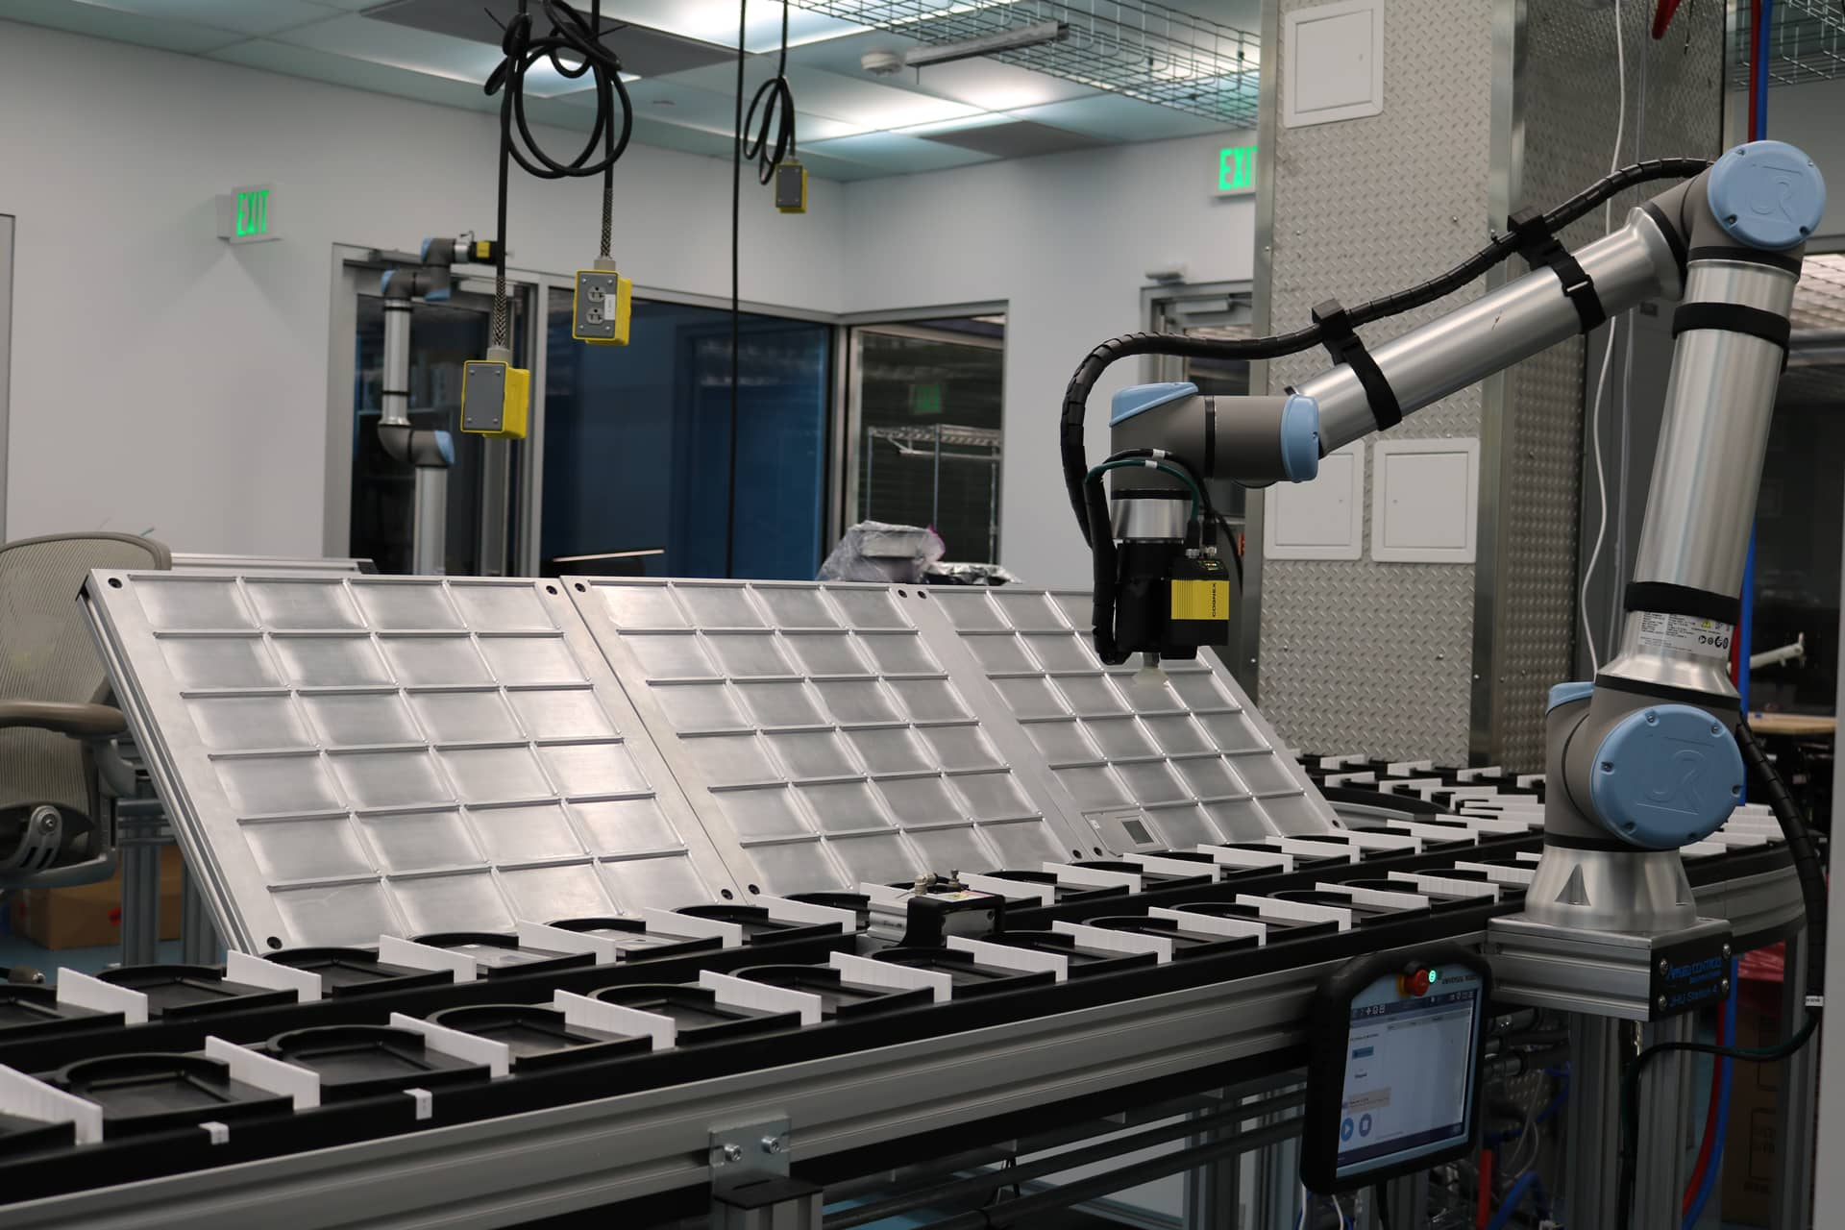
Part 3: Automate Everything

Slide 42
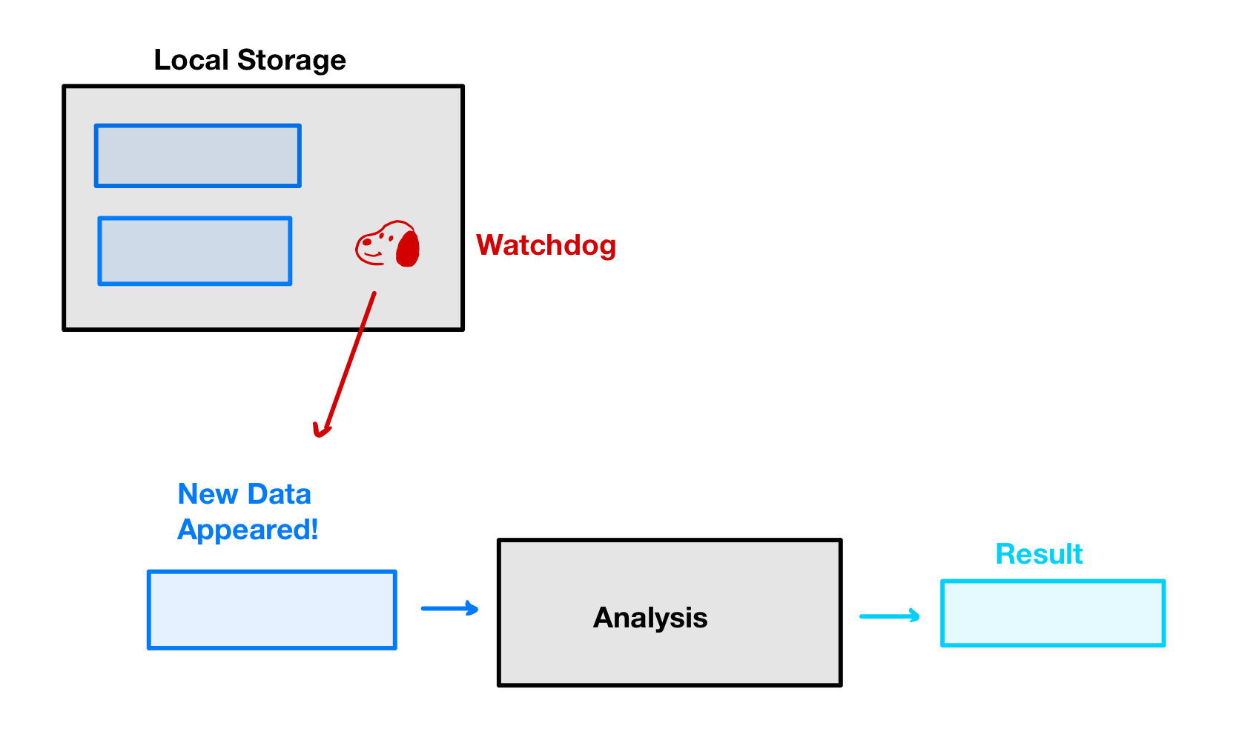

Slide 43
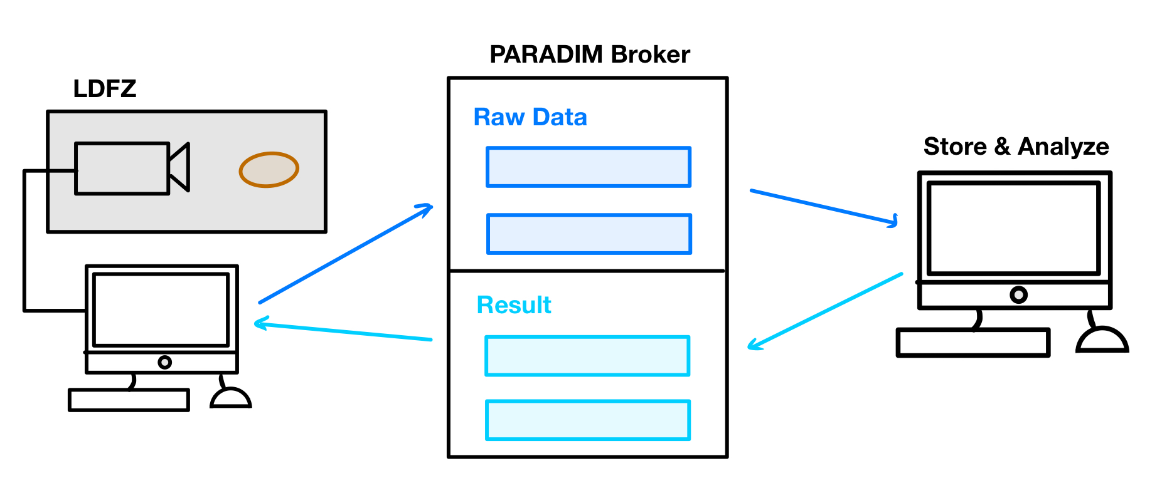
Notes:
Animate in one piece at a time

Slide 44
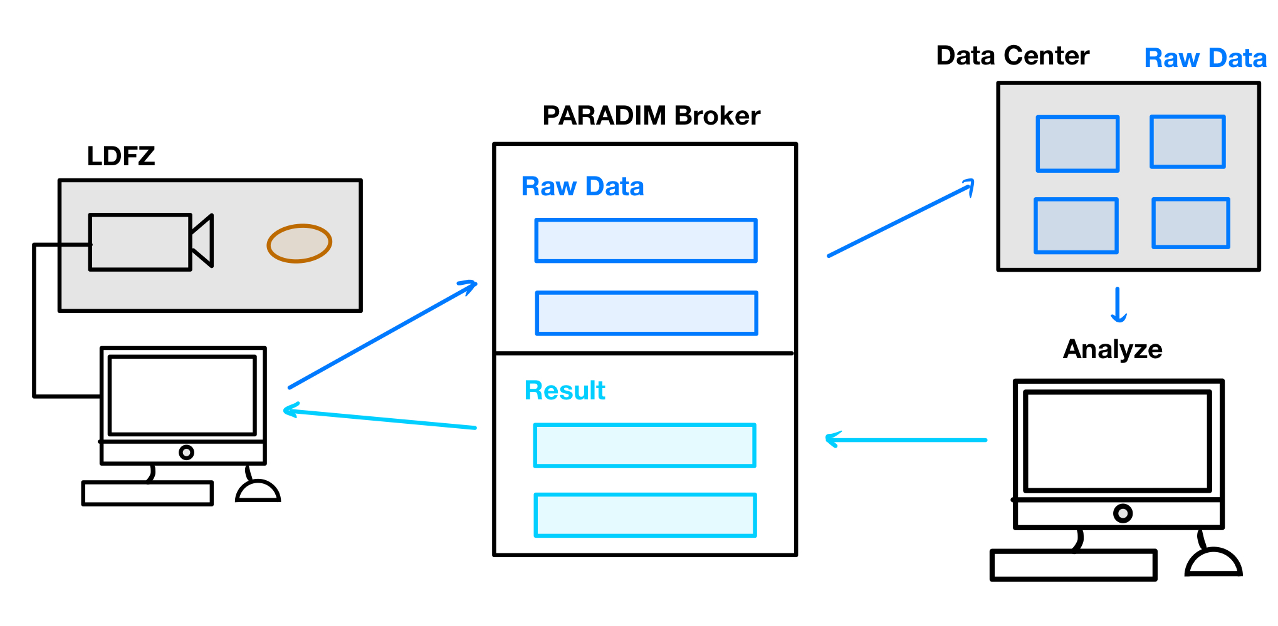

Slide 45
So, how hot was it?

Slide 46
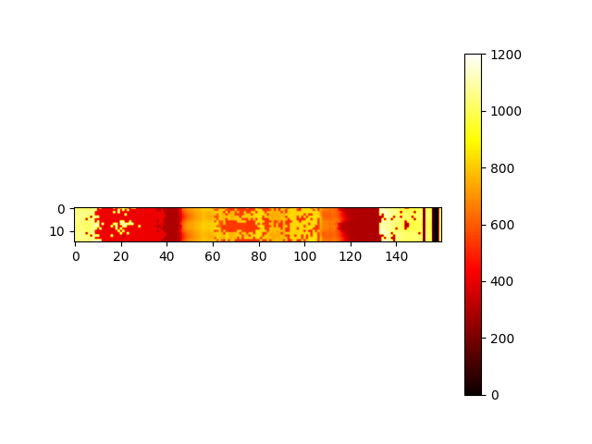
Kelvin
So, how hot was it?

Slide 47
Now the science begins…

Slide 48
Now the science begins…
Probe fundamental floating zone growth physics
Understand heat flow within the molten zone
Design growths for desired crystal properties
Adjust growths in real time

Slide 49
Acknowledgements
David
Tyrel
Evan Crites - help with using lab equipment, building the mount
Maggie Eminizer - OpenMSIStream and helping design the streaming pipeline
NSF - PARADIM #2039380 and VariMat Award 2129051

Slide 50
Kelvin
So, how hot was it?

